Slide 1
Predictive Analytics for Data Science(BUAN/MKT 6337)
Topic: Sales from Rossmann stores
(https://www.kaggle.com/competitions/rossmann-store-sales/data)
Prepared by: Rohith Thotakura(RXT200039)
Ajay Vishnu Inakollu(AXI210007)
Anudeep Chowdary Boyapati(AXB210083)
Abhiinav Reddy Padamati(AXP210116)

Slide 2
Introduction
Data: The Sales of Rossmann stores which has historical data of the number of customers, sales, Holidays, Store types.
This has data sales from 1,115 retailers. It has a time frame of 2013 to 2015.
We are tasked with predicting their daily sales for up to six weeks in advance. Reliable sales forecasts enable store managers to create effective staff schedules that increase productivity.

Slide 3
Introduction
How well sales can be increased in the Rossmann store.
What are main causes for the low sales and which characteristics are playing major role in increasing or decreasing the sales.
This is not just a specific scenario based, this business problem and the business model can be applied to all other small to mid level business.
By the end of this representation of the model, we can surely say that the model or the business can be improved more by focusing on some particular variables or factors.

Slide 4
Analysis
X Variable: In the data predictors such as State_Holidays, Promo, Assortment types of products are included for the store.
The independent variables affects the dependent variable. It can invoke the sales column relationship and variable.
The dependent variable is Sales column and the presented data is used in year 2013-2015.

Slide 5
Hypothesis testing results in more understandability if the data.
As this data has over 1M observations, this store data can be used for the effectiveness of the store purchase.
Of all the 19 variables, we can consider Promo, StateHoliday, Competition, Assortment, to check and increase the quality.
Average sales of the Rossmann store is same with Promo or not.
Average sales is not altered much with Promo or StateHoliday comparatively.

Slide 6
Methods
The Procedure includes Analysis of Variance. The significance of each variable is estimated. Used null hypothesis and two way Anova Test
Multiple linear regression is used to evaluate the sales of store in advance.

Slide 7
Data Visualization can be done in many ways:
We have created bar graphs of the variables Promo, StoreType, Assortment to the Sales column. We can see the importance of the columns by seeing the graph.
We have also plotted the graphs of the highly correlated variables after the multiple regression and from this we can say that the Promo and StoreType_b are the most effective variables paving way to the increase of sales at Rossmann store.

Slide 8
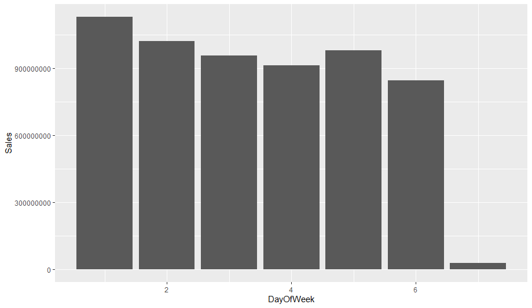
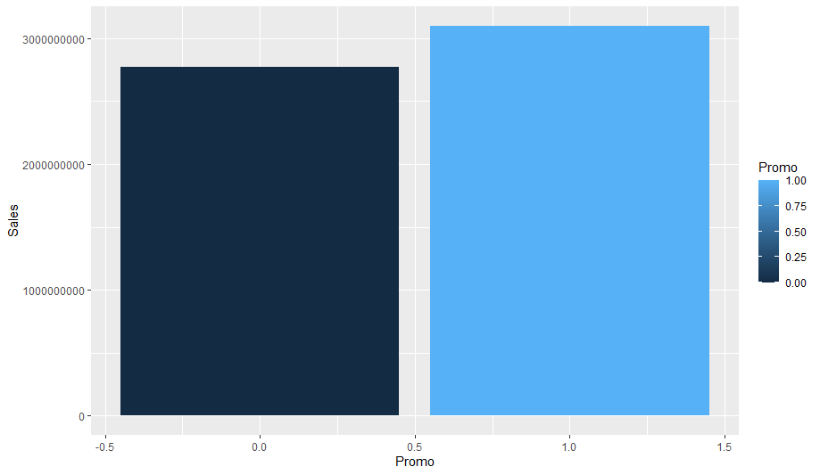
Mondays show the biggest increase in spending behavior. This is because:
a) there are no such events over the weekends.
b) most stores are closed on Sundays.
The Stores with Promo have better sales compared with Stores without Promos.

Slide 9
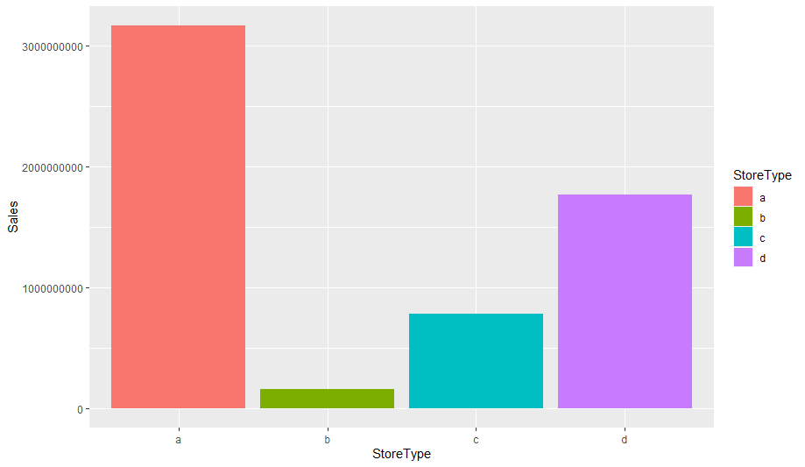
Customer base at Store Type 'b' are more likely to visit the stores just for specific promotional items and leave without buying anything else if those items weren't available. Promotional events provide negligible lift to the average spending per person.
Some customers at Store Type 'a' exhibit similar tendency, they target only specific promotional items. But overall, more customers show interest towards StoretypeA.
Customers at Store Type 'c' and 'd' are more sensitive to promotional events.

Slide 10
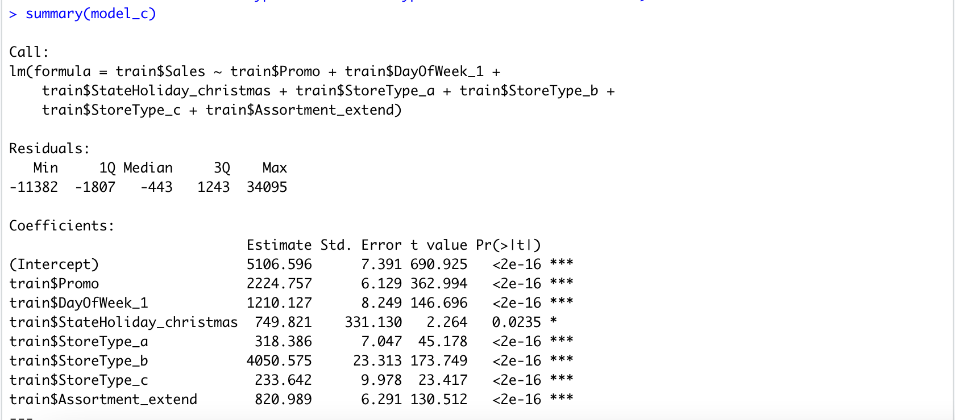
Regression
-As per this model, we have considered the multiple linear regression for this model. After fitting the model to this dataset, and doing multiple linear regression multiple times, we can finally have a set of important columns which plays a major role in affecting the sales of the Rossmann store. StoreType_b, Promo, DayOfWeek_1, Assortment_extra are the effective columns.

Slide 11
Results
After predicting, We can finally conclude that the Increase of sales
Can be done by increasing the stock at the StoreType_b
sales done through the Promo
Assortment_extra
state holiday Christmas.
Increasing the stock and managing the store with more number of employees creating a hassle free store, will result in an exponential hike of the sales than the present sales. We can also see that the Day1 of every week also result in sales of the Rossmann store.

